Slide 1
SISTEMAS OPERATIVOS
SO
E – M 2019

Slide 2
Operating-System Components
Operating-System Components (cont.)

Slide 3
Protection and Security
Protection – any mechanism for controlling access of processes or users to resources defined by the OS
Security – defense of the system against internal and external attacks
Huge range, including denial-of-service, worms, viruses, identity theft, theft of service
Systems generally first distinguish among users, to determine who can do what
User identities (user IDs, security IDs) include name and associated number, one per user
User ID then associated with all files, processes of that user to determine access control
Group identifier (group ID) allows set of users to be defined and controls managed, then also associated with each process, file
Privilege escalation allows user to change to effective ID with more rights

Slide 4
Op Sys Design and Implementation
Design and Implementation of OS not “solvable”, but some approaches have proven successful
Internal structure of different Operating Systems can vary widely
Start the design by defining goals and specifications
User goals and System goals
User goals – operating system should be convenient to use, easy to learn, reliable, safe, and fast
System goals – operating system should be easy to design, implement, and maintain, as well as flexible, reliable, error-free, and efficient
Affected by choice of hardware, type of system

Slide 5
Op Sys Design and Implementation (cont.)
Important principle to separate
Policy: specifies desired behavior or what should occur – What will be done? Mechanism: how the policy is carried out - implementation of core processing - How to do it?
Policies decide what will be done, e.g. Interval (process) Timer for CPU protection.
Mechanisms determine how to do something, e.g. Process timer to manage the slices for process user.
The separation of policy from mechanism is a very important principle, it allows maximum flexibility if policy decisions are to be changed later.
Specifying and designing an OS is highly creative task of software engineering

Slide 6
Implementation
Much variation
Early OSes in Assembly language
Then system programming languages like Algol, PL/1
Now C, C++
Actually usually a mix of languages
Lowest levels in Assembly
Main body in C
Systems programs in C, C++, scripting languages like PERL, Python, Shell scripts
More high-level language easier to port to other hardware
But slower

Slide 7
Op Sys, Organizational Structures
Op Sys, Organizational Structures
Architectures

Slide 8
Estruct Organizacionales (Arquitecturas)
Arquitecturas genéricas :
Se conforma por la manera en que las componentes del Sistema Operativo (administradores, funciones del sistema ...) se acomodan e interactúan.
Asegura un buen funcionamiento y flexibilidad para modificarse con facilidad.
Arquitecturas según Sistemas Operativos:
Cada marca de SO puede tener una arquitectura distinta.

Slide 9
Operating System Structures
Various ways to architecture (structure) ones
Monolithic
Layered
Microkernel
Client-Server
And many more …

Slide 10
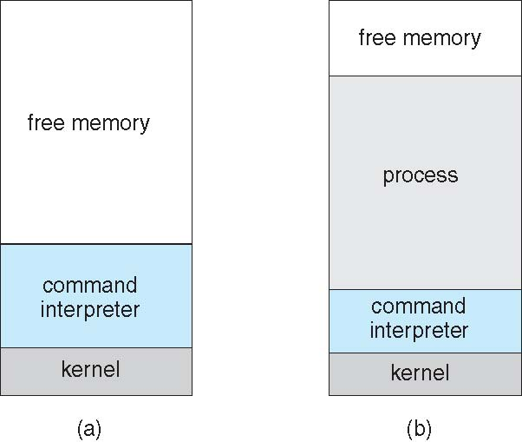
Monolithic / Simple Architectures
Single-tasking, one process
MS-DOS
Single memory space
Kernel and Shell built at boot time
Simple method to run user program
Program loaded into memory as subroutine, overwriting some part of shell
Program exits then: Shell reloaded
This kind: “The Big Mess”
Subroutine
(program user)
At system startup running a program

Slide 11
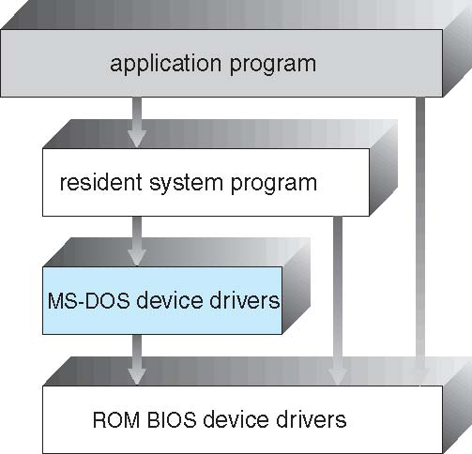
Simple Structure -- MS-DOS
MS-DOS – written to provide the most functionality in the least space
Not divided into modules
Although MS-DOS has some structure, its interfaces and levels of functionality are not well separated

Slide 12
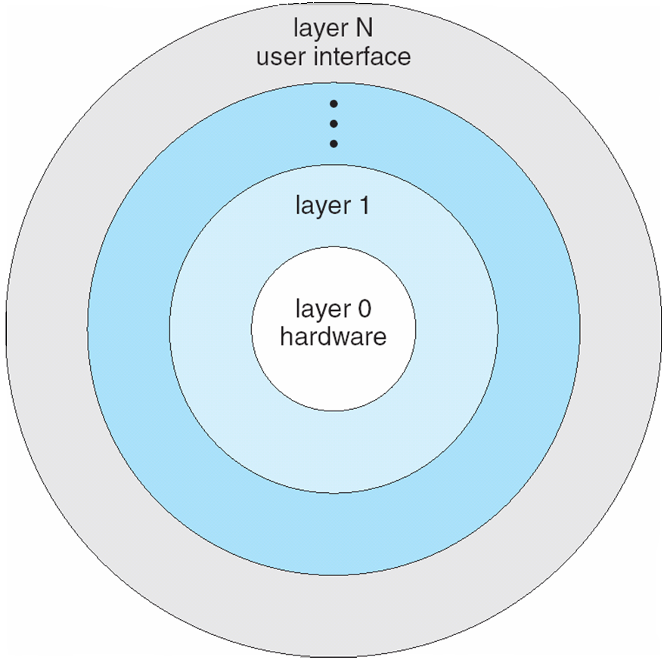
Layered Architecture
The operating system is divided into a number of hierarchical layers (levels).
Each layer built on top of lower layers.
The bottom layer (layer 0), is the hardware; the highest (layer N) is the user interface.
With modularity, layers are selected such that each uses functions (operations) and services of only lower-level layers.
Multiprogrammed, Multiuser, Time-Sharing Op Sys.

Slide 13
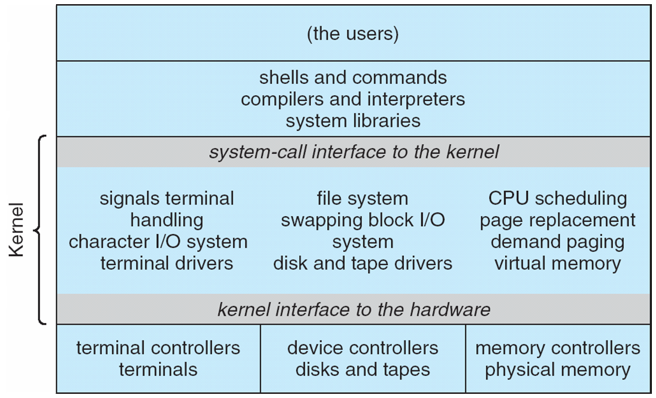
UNIX Op Sys Architecture
Beyond simple but not fully layered

Slide 14
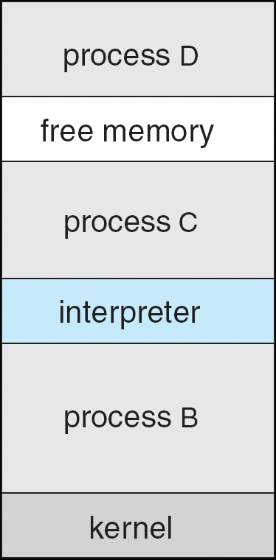
Free BSD / Unix
Unix variant
Multitasking/Time-sharing
User login -> invoke user’s choice of shell
Shell creates process
Load program into process
Shell waits for process to terminate or continues with user commands
Process

Slide 15
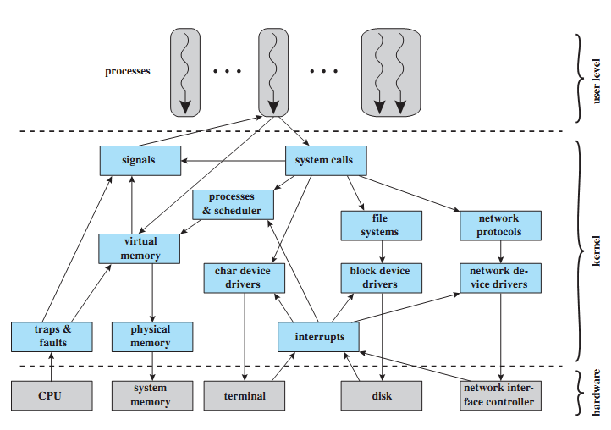
LINUX Kernel Components

Slide 16
Microkernel System Architecture
Moves as much functionality as possible from the kernel into “user” space.
Only a few essential functions in the kernel:
primitive memory management (address space)
I/O and interrupt management
Inter-Process Communication (IPC)
basic scheduling
Other ones: smallers (e.g. device drivers)
Other OS services are provided by processes running in user mode (vertical servers):
device drivers, file system, virtual memory…

Slide 17
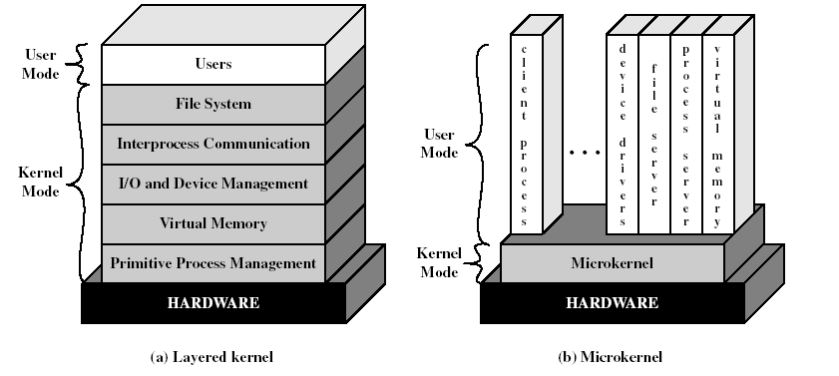
Layered vs. Microkernel Architecture

Slide 18
Microkernel System Structure
Communication takes place between user modules using message passing
Benefits:
Easier to extend a microkernel
Easier to port the operating system to new architectures
More reliable (less code is running in kernel mode)
More secure
small microkernel can be rigorously tested
Detriments:
Performance overhead of user space to kernel space communication
Examples:
Mach for MAC OS X, _______, ________

Slide 19
Microkernel System Structure

Slide 20
Client-Server Architecture
Se basa en la arquitectura de micro-kernel.
Los procesos, en un momento dado, o son procesos cliente o son procesos servidor.
Al proceso servidor se le asignan mas recursos.
Procesos clientes, inicialmente:
Procesos de usuario
Procesos servidores, inicialmente:
Los procesos de los diferentes administradores del SO.
Comunicación cliente-servidor:
Mensajes vía el microkernel
Menos capas.

Slide 21
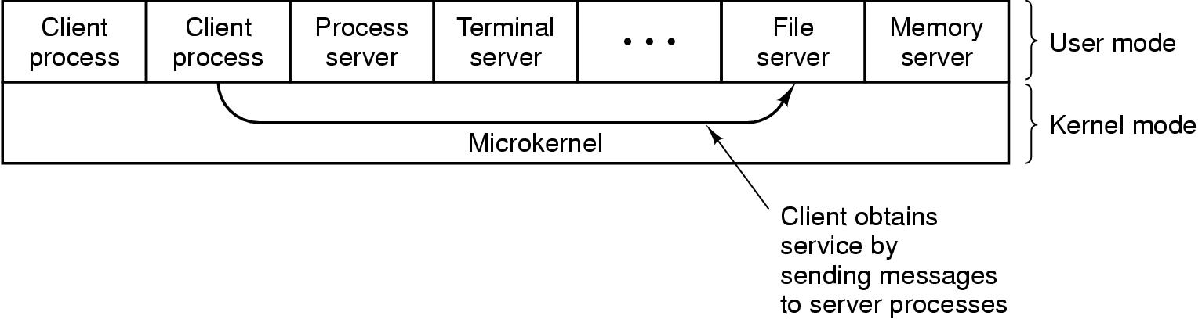
Client-Server Model
Microkernel as a “software bus”
Windows NT (3.x, 4.x, 5.x, 6.x)

Slide 22
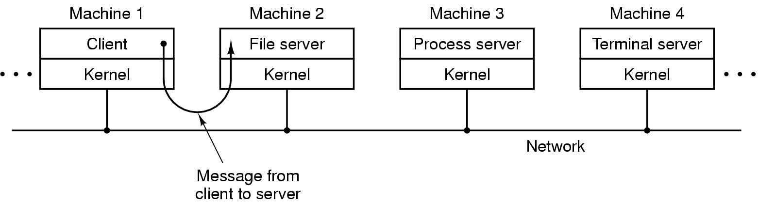
Client-Server Design
The client-server model in a Distributed System support
message are sent without knowing where the target machine (server process) is.
Micro Kernel as a communication bus.

Slide 23
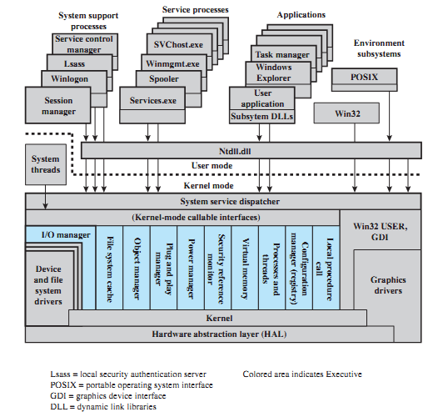
Windows v6.1 (Edition 7) Architec.

Slide 24
Windows Architecture
Place together several general architectures
Layared aproach,
MicroKernel, and
CLIENT-SERVER
And the approach supports
Distributed system (because MicroKernel).
Of course, Windows NT (3, 4, 5 or 6) is a general purpose operating system.
In which language was Windows NT programmed? ________

Slide 25
References
Presentación de Ramon Ríos.
Capítulos: Operating System Concepts; Silberschatz, Galvin, Gagne.
05-feb-2019

